Slide 1
Goal-setting and time management while working from home

Slide 2
Hello!
I’m Louise
Personal organiser
PA to chemistry professor
EA to property management team
Correspondence secretary to Vice-Chancellor

Slide 3
Purpose of this workshop
OUR PLANS VS OUR REALITY
What is the gap between where we wanted or planned to be and where we are?
TESTED TIPS, TRICKS AND IDEAS
Some general ideas for how to better work from home, or in a new situation
Notes:
I compiled this with the help of many different resources and ideas from others in CARES that have helped researchers work from home.
Grab some paper and a pen or an empty word document as there will be a few exercises throughout the presentation and it will help to write things down.

Slide 4
You are not working from home. You’re at home, during a crisis, trying to work.

Slide 5
Activity 1.
Icebreaker
What’s your name?
Have you enjoyed working from home or not (and why)?

Slide 6
My examples
More time for exercise
More self-discipline required
Worse sleep routine

Slide 7
OUR PLANS VS OUR REALITY
What does it look like to be successful during a pandemic?
Notes:
You probably had plans for 2020, expectations of yourself and expectations of what this year would look like. Considering the situation now, do your plans and expectations need readjusting? Does your idea of success need readjusting?

Slide 8
Activity 2.
Good and bad workdays
What does a good and bad day look like for you?
Notes:
“Good” and “bad” aren’t very descriptive adjectives, but try to think about how you feel at the end of a workday. Having a “good” day doesn’t necessarily mean that you got everything done or worked long hours – maybe it means that you tackled just one difficult task, or had a productive meeting with someone. Your workday doesn’t have to be perfect to be “good”. There are some examples on the next slide.

Slide 9
Examples of “good” and “bad” days
A good day
Started my workday by 9.30am
Completed a task I’d been putting off
Worked consistently on something for x hours
Did some exercise
Had a proper dinner
A bad day
Spent too much time on unimportant tasks
Put something off
Struggled to focus
Went to bed with a messy kitchen
Notes:
These are my examples of a “good” and “bad” day. Take some time to write bullet points for your own good and bad days. Think about what makes you feel a sense of achievement at the end of the day, or what has happened if you feel frustrated with yourself.

Slide 10
Activity 3.
Identifying the roadblock
What is getting in the way of you having a “good” day?
Notes:
This exercise is to help you identify what’s stopping you from doing the things on your “good day” list, or to find the gap between your expectation of yourself and what’s really happening. There are some examples on the next slide.

Slide 11
Examples of roadblocks
Struggling to focus on a particular task
Planned but unachieveable experiments
Daily routine isn’t helping you
Pick one!
Notes:
Write down some of your own roadblocks and then choose one to use in the next exercise.

Slide 12
Some questions to consider
What happens if I don’t or can never achieve this? (What are the consequences and who do they affect? When will the consequences occur?)
What happens when I do achieve this? (What changes, what can I do next?)
What is stopping me? (Is it internal, e.g. procrastination, not knowing who to ask, or external, e.g. not being able to contact someone, not being able to access your workspace?)
What do I need to be able to achieve this?
Who can I ask for help?
Notes:
Take your time and think through these questions carefully. Make some notes for each.
On consequences – sometimes the consequences of not meeting your self-expectation aren’t that bad! Maybe this expectation is one you can let go of. Or, if you really do need to meet this expectation or achieve this task, go through the next few questions and see what you find out about what’s getting in the way of this.

Slide 13
Activity 4.
Taking action
What is one thing you can change to start overcoming your roadblock?
Notes:
Taking your notes from the previous activity, write down one thing that you can do today to help yourself take the next step.

Slide 14
TESTED TIPS, TRICKS AND IDEAS
What are some practical things we can try?

Slide 15
Making a schedule or list
Write it down or print it
Keep it in a visible place
Refer to it often
Notes:
This is particularly good if you have a cluttered computer desktop and are likely to miss or not regularly check your tasks or emails. Also, don’t rely on your emails as a to-do list – you’ll miss things and this almost ensures that you won’t be working on any of your own personal goals or tasks.

Slide 16
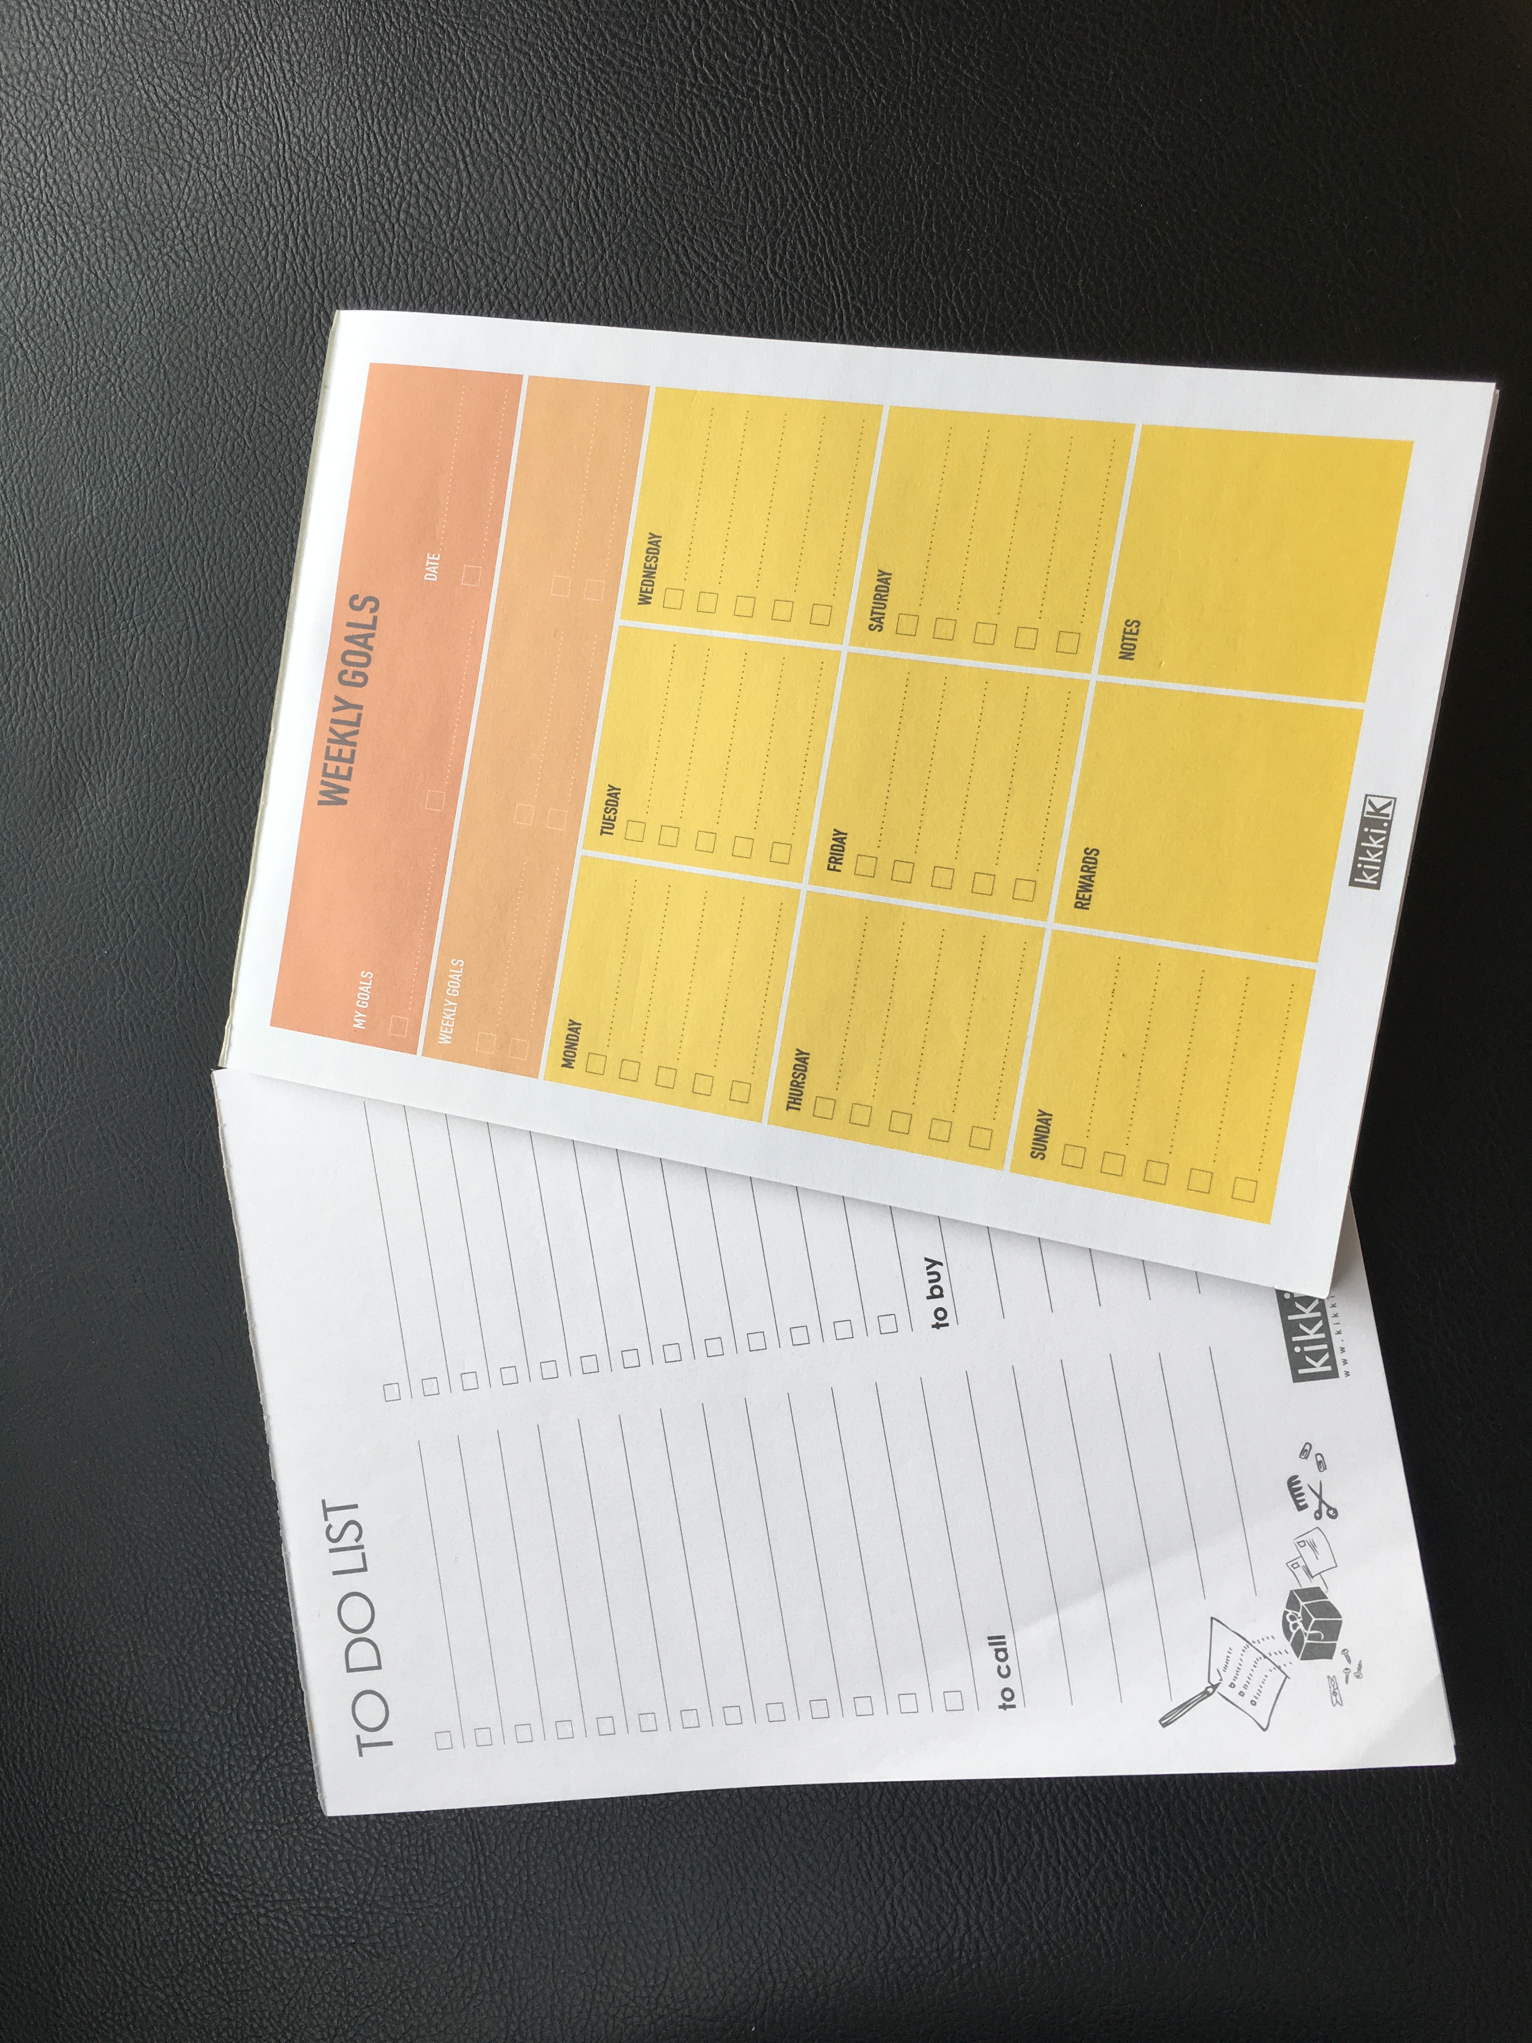
Making a schedule
Notes:
Here are some notepads I used to keep track of my tasks and goals while I was working from home in New Zealand. These worked well for me as I had a larger workspace. However, back in Singapore my desk is smaller so I use an online taskboard (Asana).

Slide 17
Asana or Trello
Particularly good for admin tasks
Good for structuring projects
Trello is good for groups
www.asana.com, www.trello.com
Notes:
There are a couple of online options for project management and general to-do lists. Both have good free versions for personal use.

Slide 18
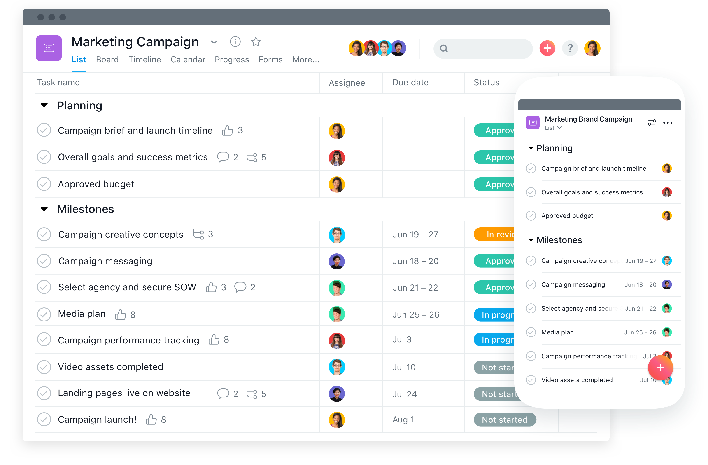
Notes:
An example of an Asana project board

Slide 19
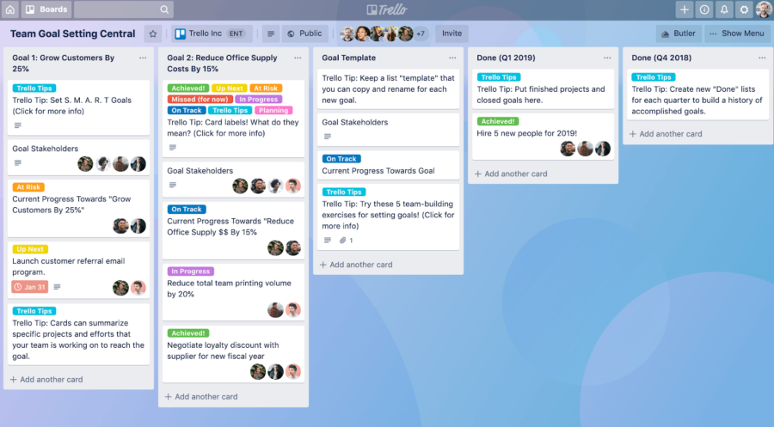
Notes:
The Trello interface

Slide 20
The to-don’t list
What makes your work less effective?
Multi-tasking
Taking too-long breaks
Not taking breaks at all
Checking the news
Trying to make things perfect
Consider using blocking software (Blocksite for Chrome, app time allocations)
Notes:
This can be a helpful tool for identifying what is getting in the way of your progress. Don’t do this every day – maybe just occasionally at the end of the week. Think about what makes you do these unhelpful things and how to reduce your time spent on them.

Slide 21
The urgent vs important matrix
URGENT
NOT URGENT
I
Crisis
Pressing problems
Projects with close deadline
II
Preparation
Planning
New opportunities
Relationship building
IMPORTANT
III
Interruptions
Some calls
Some emails
Some meetings
IV
Busy work
Some calls
Some emails
Time wasters
NOT IMPORTANT
Adapted from: https://medium.com/swlh/how-to-master-your-priorities-with-the-urgent-important-matrix-a7904de55266
Notes:
Researchers should be spending a lot of time in box II, but often end up in box III. When you’re planning your week/day, schedule in time for boxes I and II first. There will be box III interruptions that you’ll need to deal with, so leave time for these too. Try and eliminate box IV items as much as you can.

Slide 22
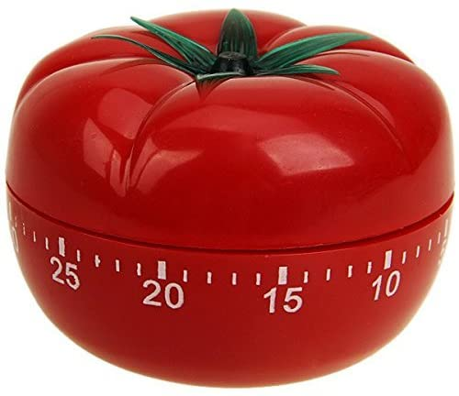
Pomodoro technique
Task-based
Intervals of work separated by short breaks
Usually 25 mins with a 5 min break
After a few sessions of work (usually 4) take a longer break
Ariga, Atsunori, and Alejandro Lleras. "Brief and rare mental “breaks” keep you focused: Deactivation and reactivation of task goals preempt vigilance decrements." Cognition 118.3 (2011): 439-443.
Notes:
This is what I use and I find it really helpful.

Slide 23
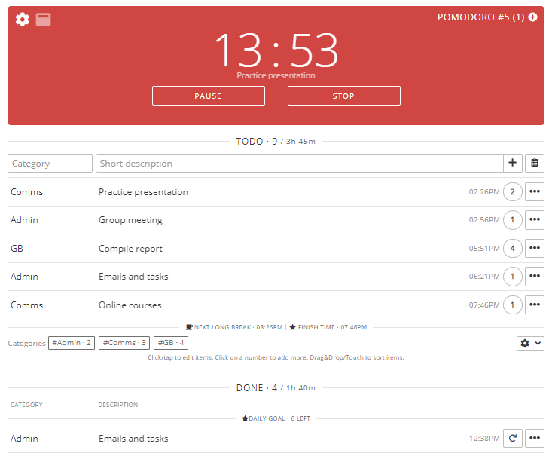
Pomodoro technique
www.pomodoro-tracker.com
Notes:
This is what the Pomodoro Tracker looks like. You can create an account to track your time spent on various tasks and then analyse your statistics after a week/month/year to see what takes up most of your time.

Slide 24
Take time off to rest!
Active rest/recovery
Going for a walk
Doing sports or exercise
Doing an online course
Baking/cooking
Going out with friends

Slide 25
Take time off to rest!
Passive rest/recovery
Sleeping
Watching Netflix
What re-energises you?

Slide 26
Find out your “tendency”
How do you respond to expectations?
Your response to inner and outer expectations determines how you respond to work tasks, deadlines etc.
Gretchen Rubin – The Four Tendencies

Slide 27
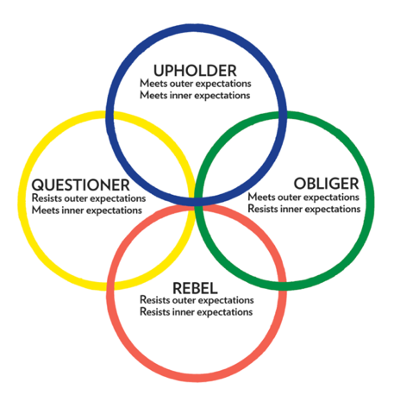
Find out your “tendency”
Gretchen Rubin – The Four Tendencies
Notes:
https://quiz.gretchenrubin.com/

Slide 28
Upholder
Readily meets outer expectations but struggles to meet inner expectations. Upholders keep their New Year’s resolution without much difficulty. They want to know what people expect from them, but their expectations for themselves are just as important.
Gretchen Rubin – The Four Tendencies

Slide 29
Obliger
Meets outer expectations but struggles to meet inner expectations. This is someone who knows he would be happier if he exercised but can’t bring himself to do so regularly. He may have been an athlete in school and when he was on a team he never missed practice.
Gretchen Rubin – The Four Tendencies

Slide 30
Questioner
Investigates all expectations–both outer and inner. Questioners want to do what they think makes sense and resist anything they deem to be arbitrary or inefficient. They always want to do know why they should do something, so they make everything an inner expectation. If it meets their inner standard, they will follow through. If it fails their inner standard, they will resist.
Gretchen Rubin – The Four Tendencies

Slide 31
Rebel
Resists all expectations, outer and inner alike. They do what they want to do, in their own way, in their own time. Rebels don’t like to be told what to do and even dislike telling themselves what to do. For instance, a Rebel would not sign up for a spin class on a Saturday because she doesn’t know what she wants to do at 10:00 am on a Saturday.
Gretchen Rubin – The Four Tendencies

Slide 32
Talking with others
Talk with family, friends, colleagues
Problem solve together
Accountability

Slide 33
Any questions?
https://intranet.cares.cam.ac.uk/
- Working From Home
- Resources
This template is free to use under Creative Commons Attribution license. https://www.slidescarnival.com/

